Slide 1
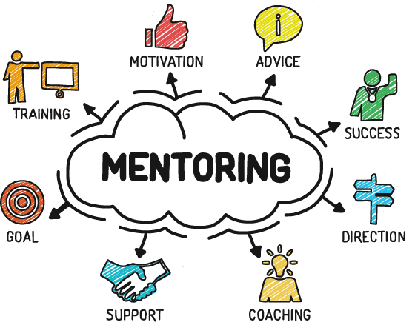
Session 6:
From Deficit to Asset-Based Mentoring

Slide 2
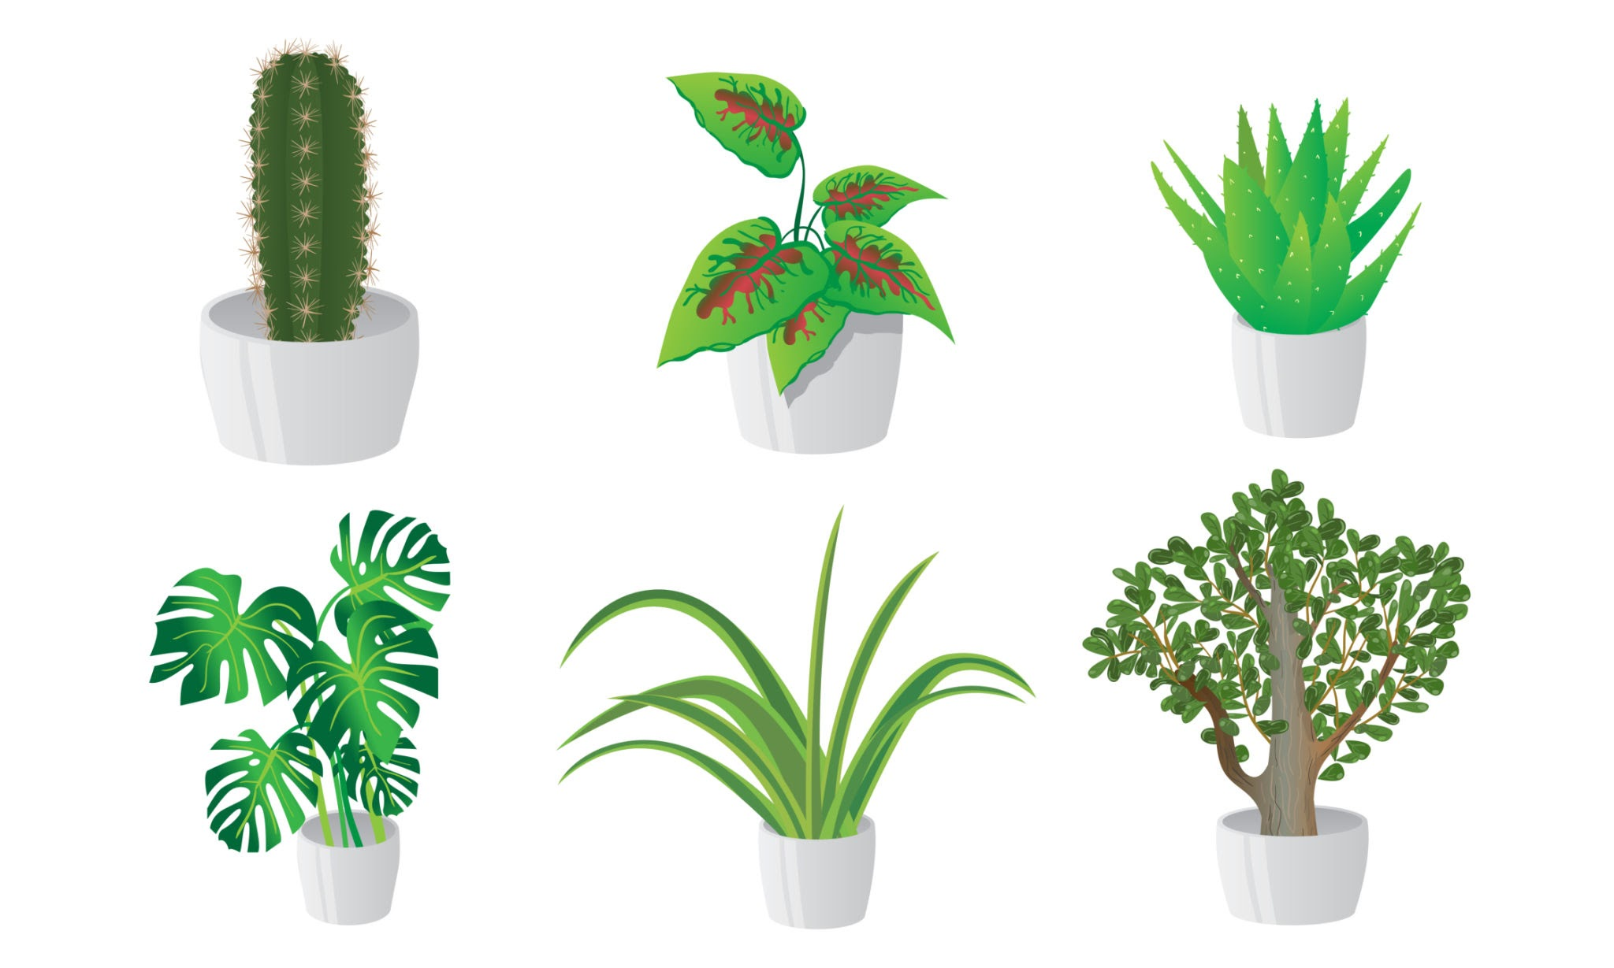
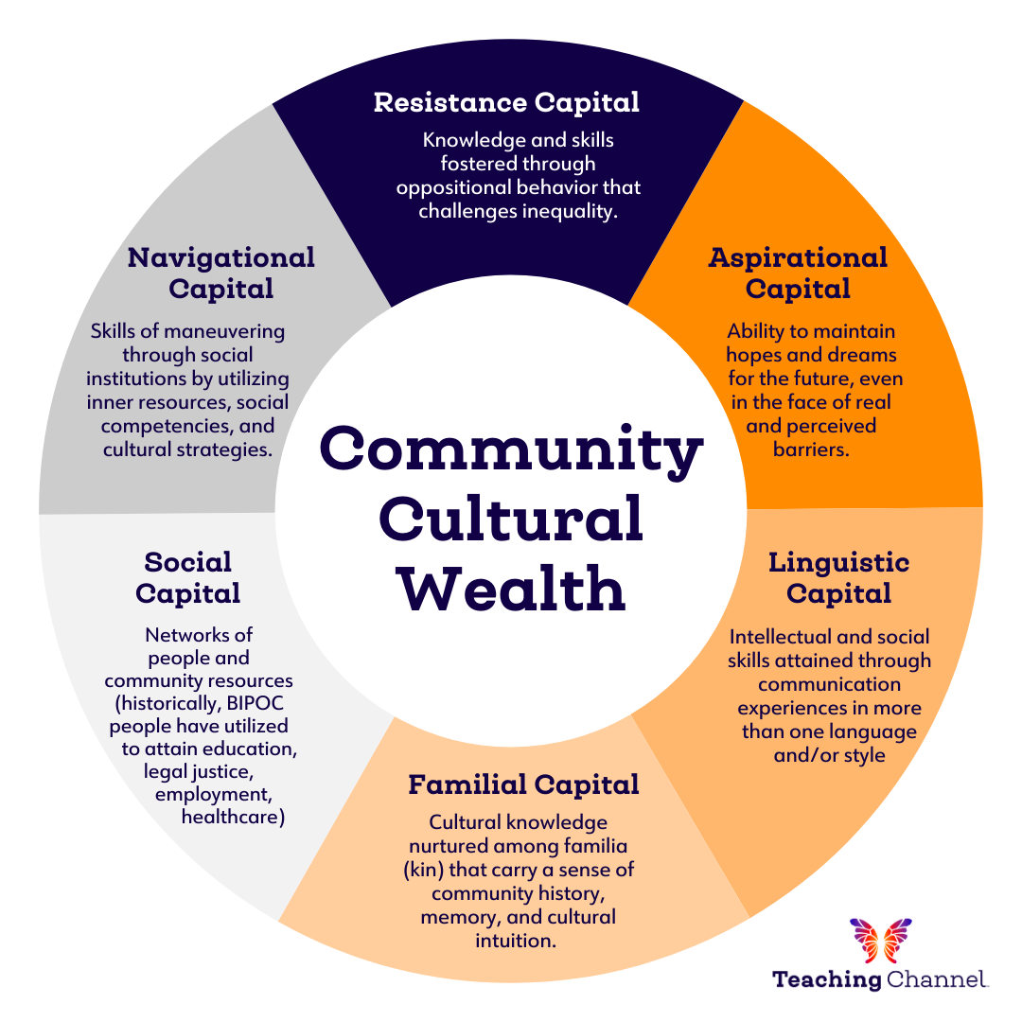
Plant Lesson #2:
We recognize that successful plant growth sometimes requires new resources and at other times the relocation of existing resources.
Example Combination
Linguistic Capital: Intellectual and social skills attained through communication experiences in more than one language and/or style
Mentoring practice: The mentor connects students with peers who are bilingual or from a similar background who can support them.

Slide 3
OPTIONS
Option 1:
Plant lesson 1: We extensively probe our environment when the plants in it are not faring well.
CCW: Aspirational capital
Option 2:
Plant lesson 3: Caretakers and their preparation, expertise, and efficacy critically matter to plant persistence and optimized survival.
CCW: Resistant capital
Option 3:
Plant lesson 4: We seek external expertise when our own caretaking efforts prove ineffective.
CCW: Social capital
Option 4:
Plant lesson 5: We attribute a failure to support plant growth to our own caretaking and stewardship inabilities
CCW: Navigational capital
Plant Lesson
CCW
Mentoring Practice

Slide 4
Plant
Lesson #1
First, we extensively probe our environment when the plants in it are not
faring well.

Slide 5
Plant
Lesson #2
We recognize that successful plant growth sometimes requires new resources and at other times the relocation of existing resources.

Slide 6
Plant
Lesson #3
We recognize that caretakers and their specific preparation, expertise, and efficacy in using these skills, critically matter to plant persistence and optimized survival.

Slide 7
Plant
Lesson #4
We seek external expertise when our own caretaking efforts prove ineffective or when we lack knowledge about the underlying causes of the impairments or limitations in plant growth.

Slide 8
Plant
Lesson #5
We attribute a failure to support plant growth to our own caretaking and
stewardship inadequacies or inabilities and seek opportunities to improve
our care regimen.

Slide 9
Plant
Lesson #6
As a very last resort, when a plant is not faring well, we may attribute this
outcome to a failure of a plant to thrive.

Slide 10
Community Cultural Wealth

Slide 11
Practical Strategies Group Discussion

